Slide 1
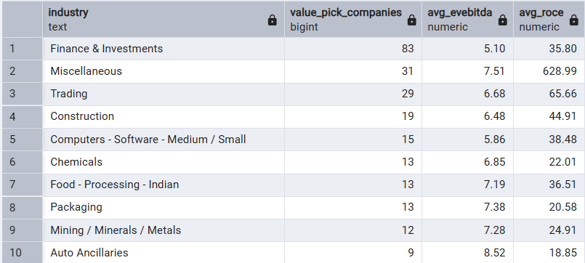
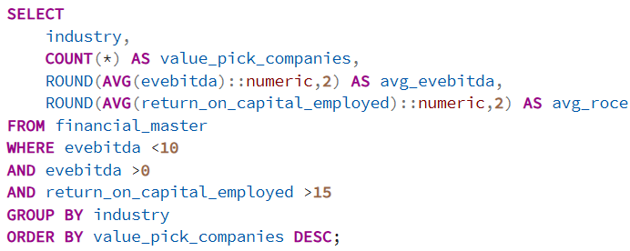
VALUATION
Question 7: Identify companies with EV/EBITDA below 10x and ROCE above 15% — are these value opportunities and which sectors dominate?
Output
Query
Recommendation:
• Validate whether low valuation is due to temporary market sentiment or structural weakness. • Prioritize companies with stable cash flow and consistent ROCE trends. • Compare with peer valuation before investment decisions.
Observation:
• Finance & Investments has the highest concentration of value-pick companies meeting both valuation and return criteria. • Trading, Construction, and Technology-related sectors also show meaningful representation. • Most selected sectors maintain healthy ROCE despite relatively lower valuation multiples.
Insight:
• Low EV/EBITDA combined with strong ROCE may indicate undervalued businesses with efficient capital utilization. • Sector concentration suggests investors may be discounting cyclical or perception-related risks despite operational strength. • These companies may offer stronger risk-adjusted return potential if profitability remains sustainable.

Slide 2
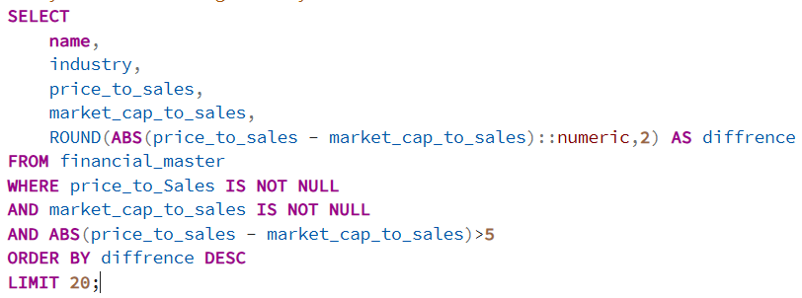

Question 8: Compare Price-to-Sales ratio vs Market Cap-to-Sales — are there significant differences indicating accounting anomalies?
Query
Output
Recommendation:
• Reconcile formula definitions and underlying financial inputs. • Review share count, consolidated reporting, and revenue treatment. • Flag extreme deviations for deeper financial due diligence.
Observation:
• Only a very limited number of companies show a noticeable gap between the two valuation measures. • The observed difference appears materially large relative to the reported ratios. • The variation suggests inconsistency between pricing and reported sales-based valuation metrics.
Insight:
• Large gaps may arise from differences in calculation methodology, capital structure, or reporting adjustments. • Such divergence can indicate that traditional valuation multiples may not fully reflect economic value. • This requires validation before using valuation conclusions.

Slide 3
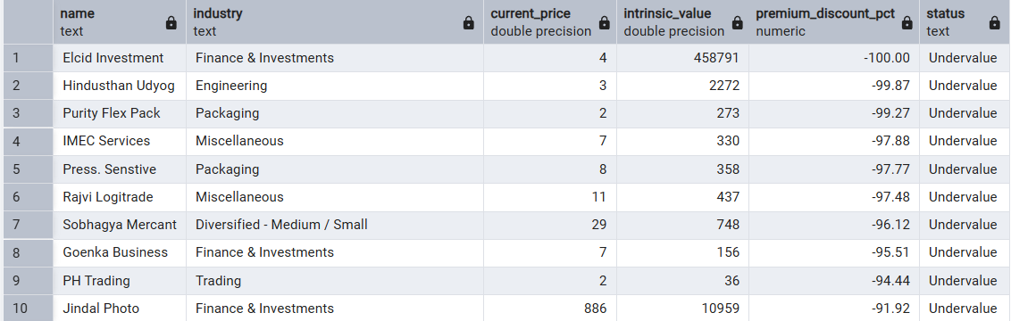
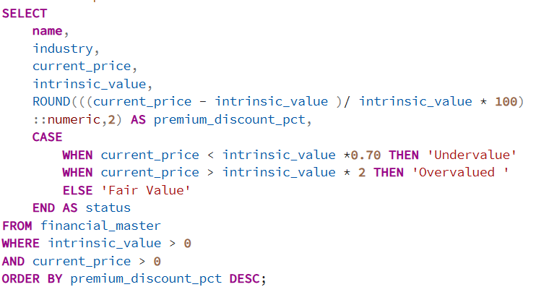
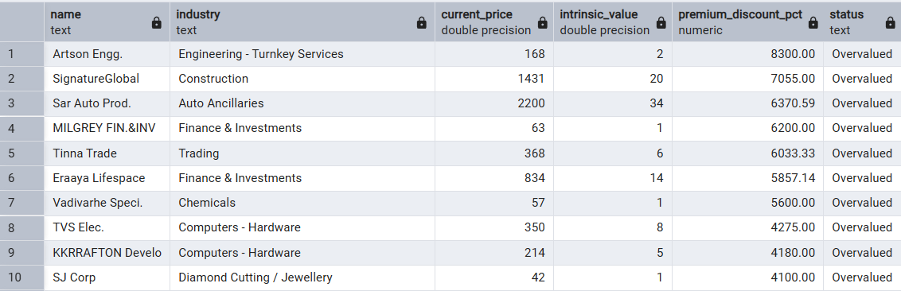
Question 9: Compare Intrinsic Value vs Current Price — how many companies are undervalued (30%+) and how many are 2x+ overvalued?
Output
Query
Observation:
• The dataset shows a larger presence of extreme valuation gaps on both undervalued and overvalued sides. • Several companies trade substantially below estimated intrinsic value, while others trade at multiples far above intrinsic estimates. • Finance-related sectors appear repeatedly in the undervalued list.
Recommendation:
• Prioritize undervalued companies with improving fundamentals. • Avoid overvalued names unless supported by sustainable growth. • Combine valuation with profitability and cash flow analysis.
Insight:
• Deep undervaluation may reflect weak sentiment, liquidity constraints, or perceived business risk. • Extreme overvaluation often signals high growth expectations already priced into the market. • Intrinsic value alone should not drive decisions without growth and quality validation.

Slide 4
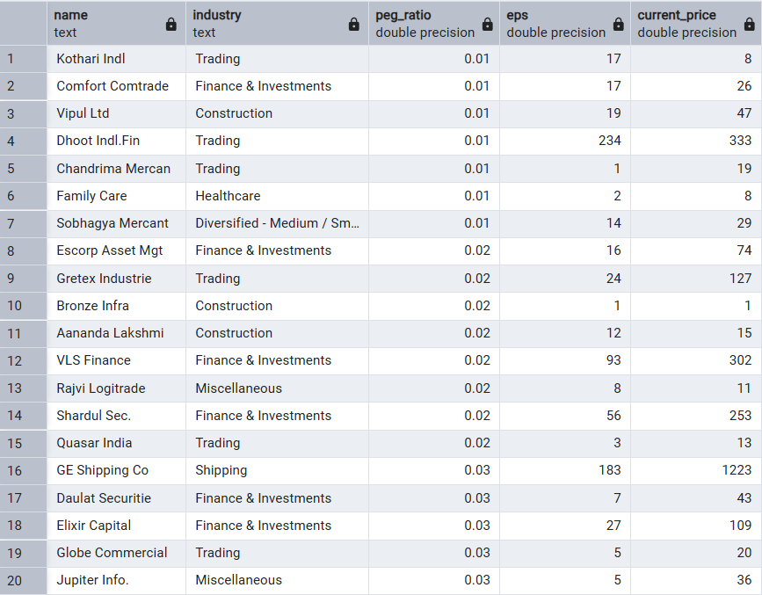
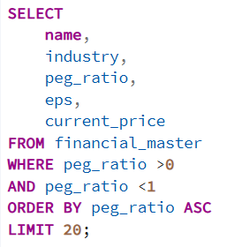
Question 11: Identify high-growth companies with PEG ratio below 1 (Growth at a reasonable price).
Output
Query
Observation:
• Multiple companies qualify with PEG below 1, indicating earnings growth exceeds valuation multiples. • Finance & Investments, Trading, and Construction appear frequently in the selection. • Several names combine strong EPS growth with relatively moderate market pricing.
Recommendation:
• Focus on companies with consistent earnings growth and healthy margins. • Validate that growth is operational rather than one-time driven. • Track earnings revisions and valuation re-rating potential.
Insight:
• Low PEG companies may represent attractive growth opportunities not fully recognized by the market. • Sector concentration suggests selective pockets of growth remain reasonably valued. • However, growth sustainability remains the key differentiator.

